Slide 1
AZ-700T00A Module 03: Design and implement Azure ExpressRoute

Slide 2
Module Overview
Lesson 01: Explore Azure ExpressRoute
Lesson 06: Connect an ExpressRoute circuit to a VNet
Lesson 02: Design an ExpressRoute deployment
Lesson 07: Connect geographically dispersed networks with ExpressRoute Global Reach
Lesson 03: Exercise - Configure an ExpressRoute Gateway
Lesson 08: Improve data path performance between networks with ExpressRoute FastPath
Lesson 04: Exercice - Provision an ExpressRoute circuit
Lesson 09: Troubleshoot ExpressRoute connection issues
Lesson 05: Configure peering for an ExpressRoute deployment
Notes:
Module overview
Design, implement, and manage Azure ExpressRoute
• choose between provider and direct model (ExpressRoute Direct)
• design and implement Azure cross-region connectivity between multiple ExpressRoute locations
• select an appropriate ExpressRoute SKU and tier
• design and implement ExpressRoute Global Reach
• design and implement ExpressRoute FastPath
• choose between private peering only, Microsoft peering only, or both
• configure private peering
• configure Microsoft peering
• create and configure an ExpressRoute gateway
• connect a virtual network to an ExpressRoute circuit
• recommend a route advertisement configuration
• configure encryption over ExpressRoute
• implement Bidirectional Forwarding Detection
• diagnose and resolve ExpressRoute connection issues

Slide 3
Lesson 01: Explore Azure ExpressRoute

Slide 4
Explore Azure ExpressRoute Overview
ExpressRoute Capabilities
Configure encryption over ExpressRoute
Understand use cases for Azure ExpressRoute
Create a zone redundant VNET gateway in Azure Availability zones
ExpressRoute connectivity models
Review
Design considerations for ExpressRoute deployments
Bidirectional Forwarding Detection (BFD)

Slide 5
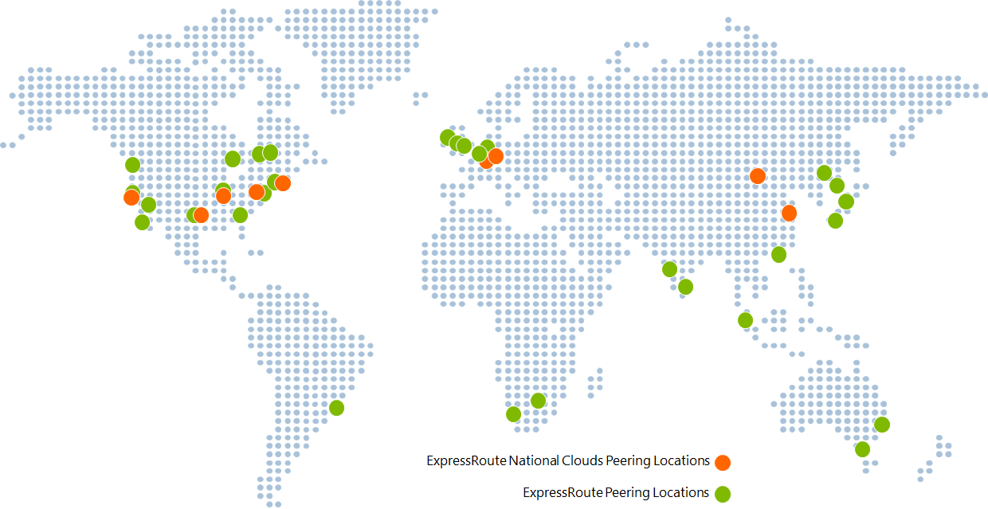
ExpressRoute Capabilities
Layer 3 connectivity with redundancy
Connectivity to all regions within a geography
Global connectivity with ExpressRoute premium add-on
Across on-premises connectivity with ExpressRoute Global Reach
Bandwidth options – 50 Mbps to 100 Gbps
Billing models – Unlimited, metered
Notes:
ExpressRoute overview - https://docs.microsoft.com/en-us/azure/expressroute/expressroute-introduction
Some key benefits of ExpressRoute are:
Layer 3 connectivity between your on-premises network and the Microsoft Cloud through a connectivity provider
Connectivity can be from an any-to-any (IPVPN) network, a point-to-point Ethernet connection, or through a virtual cross-connection via an Ethernet exchange
Connectivity to Microsoft cloud services across all regions in the geopolitical region
Global connectivity to Microsoft services across all regions with the ExpressRoute premium add-on
Built-in redundancy in every peering location for higher reliability
Azure ExpressRoute is used to create private connections between Azure datacenters and infrastructure on your premises or in a colocation environment. ExpressRoute connections do not go over the public Internet, and they offer more reliability, faster speeds, and lower latencies than typical Internet connections.

Slide 6
Understand use cases for Azure ExpressRoute
Faster and Reliable connection to Azure services
Built in redundant circuits
Storage, backup, and Recovery
Border Gateway Protocol (BGP)
Extends Data center capabilities
Integrates with existing Multiprotocol Label Switching (MPLS)
Predictable, reliable, and high-throughput connections
SLA
Private connection to Microsoft cloud
Notes:
Faster and Reliable connection to Azure services - Organizations leveraging Azure services look for reliable connections to Azure services and data centers. Public internet is dependent upon many factors and may not be suitable for a business. Azure ExpressRoute is used to create private connections between Azure data centers and infrastructure on your premises or in a colocation environment. Using ExpressRoute connections to transfer data between on-premises systems and Azure can also give significant cost benefits.
Storage, backup, and Recovery - Backup and Recovery are important for an organization for business continuity and recovering from outages. ExpressRoute gives you a fast and reliable connection to Azure with bandwidths up to 100 Gbps, which makes it excellent for scenarios such as periodic data migration, replication for business continuity, disaster recovery and other high-availability strategies.
Extends Data center capabilities - ExpressRoute can be used to connect and add compute and storage capacity to your existing data centers. With high throughput and fast latencies, Azure will feel like a natural extension to or between your data centers, so you enjoy the scale and economics of the public cloud without having to compromise on network performance.
Predictable, reliable, and high-throughput connections - With predictable, reliable, and high-throughput connections offered by ExpressRoute, enterprises can build applications that span on-premises infrastructure and Azure without compromising privacy or performance. For example, run a corporate intranet application in Azure that authenticates your customers with an on-premises Active Directory service, and serve all your corporate customers without traffic ever routing through the public Internet.
SLA: SLA for Azure ExpressRoute | Microsoft Azure

Slide 7
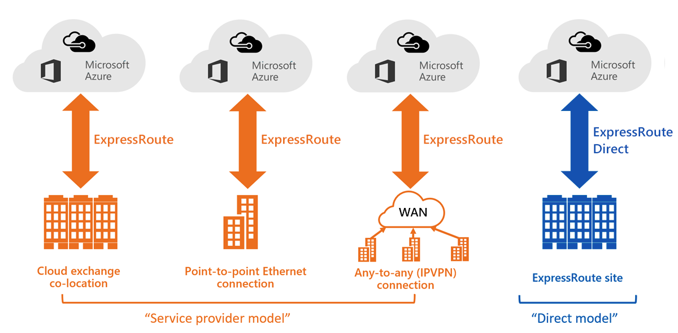
ExpressRoute connectivity models
Notes:
You can create a connection between your on-premises network and the Microsoft cloud in four different ways, CloudExchange Co-location, Point-to-point Ethernet Connection, Any-to-any (IPVPN) Connection, and ExpressRoute Direct. Connectivity providers may offer one or more connectivity models. You can work with your connectivity provider to pick the model that works best for you.
ExpressRoute Direct gives you the ability to connect directly into Microsoft’s global network at peering locations strategically distributed around the world. ExpressRoute Direct provides dual 100 Gbps or 10-Gbps connectivity, which supports Active/Active connectivity at scale. You can work with any service provider for ER Direct.
Key features that ExpressRoute Direct provides include, but aren't limited to:
Massive Data Ingestion into services like Storage and Cosmos DB
Physical isolation for industries that are regulated and require dedicated and isolated connectivity like: Banking, Government, and Retail
Granular control of circuit distribution based on business unit
Azure ExpressRoute: Connectivity models | Microsoft Docs

Slide 8
Design considerations for ExpressRoute deployments
ExpressRoute using a Service Provider | ExpressRoute Direct
Uses service providers to enable fast onboarding and connectivity into existing infrastructure | Requires 100 Gbps/10 Gbps infrastructure and full management of all layers
Integrates with hundreds of providers including Ethernet and MPLS | Direct/Dedicated capacity for regulated industries and massive data ingestion
Circuits SKUs from 50 Mbps to 10 Gbps | Customer may select a combination of the following circuit SKUs on 100-Gbps ExpressRoute Direct: (5 Gbps, 10 Gbps, 40 Gbps, 100 Gbps) Customer may select a combination of the following circuit SKUs on 10-Gbps ExpressRoute Direct: (1 Gbps, 2 Gbps, 5 Gbps, 10 Gbps )
Optimized for single tenant | Optimized for single tenant with multiple business units and multiple work environments
Notes:
Azure ExpressRoute: Routing requirements | Microsoft Docs
https://docs.microsoft.com/azure/expressroute/expressroute-routing#bgp

Slide 9
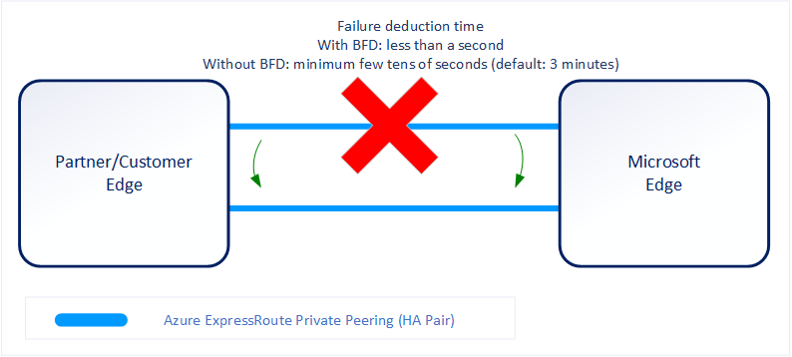
Bidirectional Forwarding Detection (BFD) with ExpressRoute Private Peering
BFD is configured by default
You only need to configure BFD on both your primary and secondary devices
You configure the BFD on the interface and then link it to the BGP session.
Notes:
BFD is configured by default under all the newly created ExpressRoute private peering interfaces on the MSEEs. As such, to enable BFD, you only need to configure BFD on both your primary and secondary devices. Configuring BFD is two-step process. You configure the BFD on the interface and then link it to the BGP session.
When you disable a peering, the Border Gateway Protocol (BGP) session for both the primary and the secondary connection of your ExpressRoute circuit is shut down. When you enable a peering, the BGP session on both the primary and the secondary connection of your ExpressRoute circuit is restored.
ExpressRoute supports Bidirectional Forwarding Detection (BFD) both over private and Microsoft peering. When you enable BFD over ExpressRoute, you can speed up the link failure detection between Microsoft Enterprise edge (MSEE) devices and the routers that your ExpressRoute circuit gets configured (CE/PE). You can configure ExpressRoute over your edge routing devices or your Partner Edge routing devices (if you went with managed Layer 3 connection service). This section walks you through the need for BFD, and how to enable BFD over ExpressRoute.
You can enable ExpressRoute circuit either by Layer 2 connections or managed Layer 3 connections. In both cases, if there are more than one Layer-2 devices in the ExpressRoute connection path, the responsibility of detecting any link failures in the path lies with the overlying BGP session.
On the MSEE devices, BGP keep-alive and hold-time are typically configured as 60 and 180 seconds, respectively. For that reason, when a link failure happens it can take up to three minutes to detect any link failure and switch traffic to alternate connection.
You can control the BGP timers by configuring a lower BGP keep-alive and hold-time on your edge peering device. If the BGP timers are not the same between the two peering devices, the BGP session will establish using the lower time value. The BGP keep-alive can be set as low as three seconds, and the hold-time as low as 10 seconds. However, setting a very aggressive BGP timer is not recommended because the protocol is process intensive.
In this scenario, BFD can help. BFD provides low-overhead link failure detection in a sub second time interval.
The following diagram shows the benefit of enabling BFD over an ExpressRoute circuit:

Slide 10
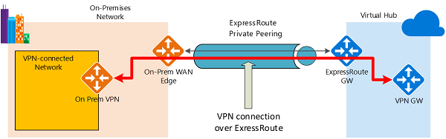
Configure encryption over ExpressRoute
Establish ExpressRoute connectivity with an ExpressRoute circuit and private peering
Establish the VPN connectivity over ExpressRoute
Routing between the on-premises networks and Azure over both the ExpressRoute and VPN paths
Notes:
Traffic from on-premises networks to Azure
For traffic from on-premises networks to Azure, the Azure prefixes (including the virtual hub and all the spoke virtual networks connected to the hub) are advertised via both the ExpressRoute private peering BGP and the VPN BGP. This results in two network routes (paths) toward Azure from the on-premises networks:
One over the IPsec-protected path
One directly over ExpressRoute without IPsec protection
To apply encryption to the communication, you must make sure that for the VPN-connected network in the diagram, the Azure routes via on-premises VPN gateway are preferred over the direct ExpressRoute path.
Traffic from Azure to on-premises networks
The same requirement applies to the traffic from Azure to on-premises networks. To ensure that the IPsec path is preferred over the direct ExpressRoute path (without IPsec), you have two options:
Advertise more specific prefixes on the VPN BGP session for the VPN-connected network. You can advertise a larger range that encompasses the VPN-connected network over ExpressRoute private peering, then more specific ranges in the VPN BGP session. For example, advertise 10.0.0.0/16 over ExpressRoute, and 10.0.1.0/24 over VPN.
Advertise disjoint prefixes for VPN and ExpressRoute. If the VPN-connected network ranges are disjoint from other ExpressRoute connected networks, you can advertise the prefixes in the VPN and ExpressRoute BGP sessions, respectively. For example, advertise 10.0.0.0/24 over ExpressRoute, and 10.0.1.0/24 over VPN.
In both examples, Azure will send traffic to 10.0.1.0/24 over the VPN connection rather than directly over ExpressRoute without VPN protection.
:

Slide 11
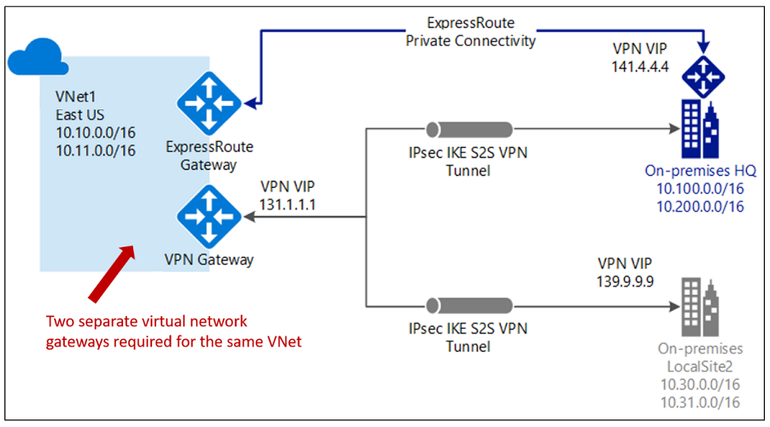
Coexisting Site-to-Site and ExpressRoute
Use S2S VPN as a secure failover path for ExpressRoute
Use S2S VPNs to connect to sites that are not connected with ExpressRoute
Notice two VNet gateways for the same virtual network
Notes:
Tutorial: Create and modify an ExpressRoute circuit - https://docs.microsoft.com/en-us/azure/expressroute/expressroute-howto-circuit-portal-resource-manager
Connect your on-premises network to the Microsoft global network by using ExpressRoute - https://docs.microsoft.com/en-us/learn/modules/connect-on-premises-network-with-expressroute/
Two gateways (VPN & Expressroute) can be enabled on the same gateway subnet by using PowerShell.
Having the ability to configure Site-to-Site VPN and ExpressRoute has several advantages. You can configure Site-to-Site VPN as a secure failover path for ExpressRoute or use Site-to-Site VPNs to connect to sites that are not connected through ExpressRoute.
Configuring Site-to-Site VPN and ExpressRoute coexisting connections has several advantages:
You can configure a Site-to-Site VPN as a secure failover path for ExpressRoute.
Alternatively, you can use Site-to-Site VPNs to connect to sites that are not connected through ExpressRoute.
Limits and limitations
Only route-based VPN gateway is supported. You must use a route-based VPN gateway. You also can use a route-based VPN gateway with a VPN connection configured for 'policy-based traffic selectors'.
The ASN of Azure VPN Gateway must be set to 65515. Azure VPN Gateway supports the BGP routing protocol. For ExpressRoute and Azure VPN to work together, you must keep the Autonomous System Number of your Azure VPN gateway at its default value, 65515. If you previously selected an ASN other than 65515 and you change the setting to 65515, you must reset the VPN gateway for the setting to take effect.
The gateway subnet must be /27 or a shorter prefix, (such as /26, /25), or you will receive an error message when you add the ExpressRoute virtual network gateway.
Coexistence in a dual stack VNet is not supported. If you are using ExpressRoute IPv6 support and a dual-stack ExpressRoute gateway, coexistence with VPN Gateway will not be possible.

Slide 12
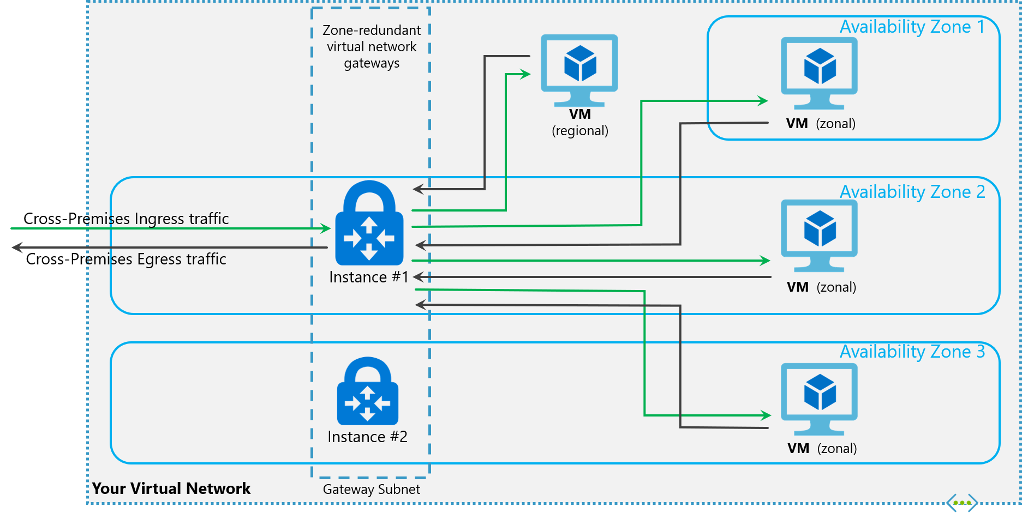
Create a zone redundant VNET gateway in Azure Availability zones

Slide 13
Design an ExpressRoute deployment Review
Knowledge Check Questions
Microsoft Learn Modules (docs.microsoft.com/Learn)
Connect your on-premises network to the Microsoft global network by using ExpressRoute
Configure the network for your virtual machines
Notes:
Learn - https://docs.microsoft.com/en-us/learn/browse/

Slide 14
Lesson 02: Design an ExpressRoute deployment

Slide 15
Design an ExpressRoute deployment Overview
ExpressRoute SKUs and Tiers
Choose a peering location
Choose the right ExpressRoute Circuit and billing model
Demonstration
Review

Slide 16
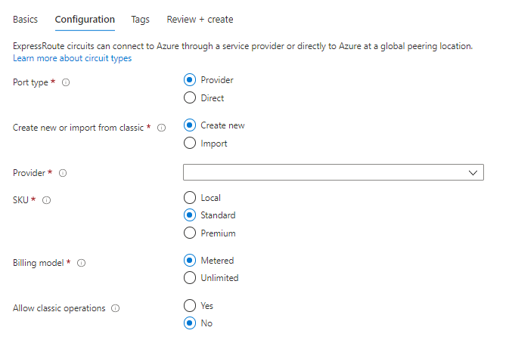
ExpressRoute SKUs
Local (if available) - provides free egress data transfer and gives you access to only 1-2 Azure regions in the same area as your circuit
Standard SKU - gives you access to all Azure regions in a geopolitical area
Premium SKU - provides support for more than 4K routes, ability to connect to more than 10 virtual networks, and global connectivity
Notes:
Local provides free egress data transfer and gives you access to only 1-2 Azure regions in the same area as your circuit. Standard gives you access to all Azure regions in the same geopolitical region as your circuit. Premium provides support for more than 4K routes, ability to connect to more than 10 virtual networks, and global connectivity. Premium also gives you access to your services deployed worldwide.
Azure ExpressRoute has three different circuit SKUs: Local, Standard, and Premium. The way you are charged for your ExpressRoute usage varies between these three SKU types.
Local SKU - With Local SKU, you are automatically charged with an Unlimited data plan.
Standard and Premium SKU - You can select between a Metered or an Unlimited data plan. All ingress data are free of charge except when using the Global Reach add-on.

Slide 17
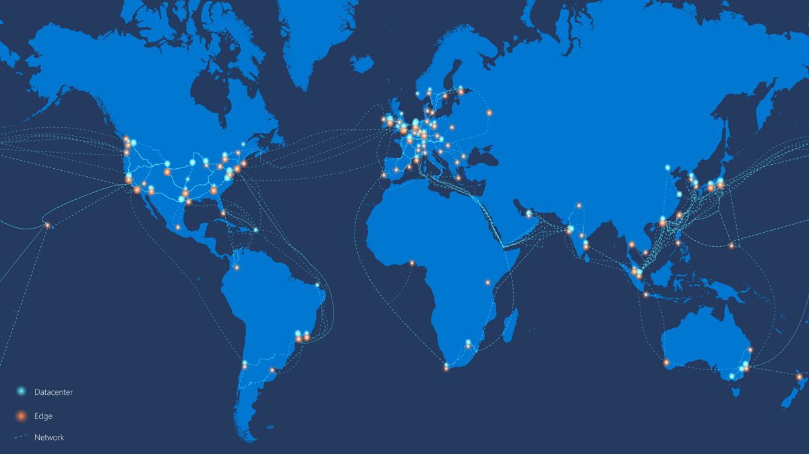
Choose a peering location
Notes:
Connectivity providers and locations: Azure ExpressRoute | Microsoft Docs
ExpressRoute locations (sometimes referred to as peering locations or meet-me-locations) are co-location facilities where Microsoft Enterprise Edge (MSEE) devices are located. ExpressRoute locations are the entry point to Microsoft's network – and are globally distributed, providing customers the opportunity to connect to Microsoft's network around the world. These locations are where ExpressRoute partners and ExpressRoute Direct customers issue cross connections to Microsoft's network. In general, the ExpressRoute location does not need to match the Azure region. For example, a customer can create an ExpressRoute circuit with the resource location East US, in the Seattle Peering location.
You will have access to Azure services across all regions within a geopolitical region if you connected to at least one ExpressRoute location within the geopolitical region.

Slide 18
Choose the right ExpressRoute Circuit and billing model
Unlimited data. Billing is based on a monthly fee; all inbound and outbound data transfer is included free of charge.
Choose Metered or unlimited data plan
Choose Bandwidth
Metered data. Billing is based on a monthly fee; all inbound data transfer is free of charge. Outbound data transfer is charged per GB of data transfer. Data transfer rates vary by region.
You can increase gateway size but not decrease without service outage
Pricing varies by region and zone
ExpressRoute premium add-on. ExpressRoute premium is an add-on to the ExpressRoute circuit.
Notes:
Check your EA agreement for your price
Prices vary by region
View pricing here: Pricing - ExpressRoute | Microsoft Azure
you can purchase ExpressRoute circuits for a wide range of bandwidths. The supported bandwidths are listed as followed. Be sure to check with your connectivity provider to determine the bandwidths they support.
50 Mbps
100 Mbps
200 Mbps
500 Mbps
1 Gbps
2 Gbps
5 Gbps
10 Gbps
You can pick a billing model that works best for you. Choose between the billing models listed as followed. For more information, see ExpressRoute FAQ.
Unlimited data. Billing is based on a monthly fee; all inbound and outbound data transfer is included free of charge.
Metered data. Billing is based on a monthly fee; all inbound data transfer is free of charge. Outbound data transfer is charged per GB of data transfer. Data transfer rates vary by region.
ExpressRoute premium add-on. ExpressRoute premium is an add-on to the ExpressRoute circuit. The ExpressRoute premium add-on provides the following capabilities:
Increased route limits for Azure public and Azure private peering from 4,000 routes to 10,000 routes.
Global connectivity for services. An ExpressRoute circuit created in any region (excluding national clouds) will have access to resources across every other region in the world. For example, a virtual network created in West Europe can be accessed through an ExpressRoute circuit provisioned in Silicon Valley.
Increased number of VNet links per ExpressRoute circuit from 10 to a larger limit, depending on the bandwidth of the circuit.

Slide 19
Demonstration
Review and deploy ExpressRoute circuit
Review and deploy ExpressRoute gateway
Notes:
Consider showing the students the two resources necessary for the ExpressRoute deployment – circuit and gateway

Slide 20
Design for an ExpressRoute deployment - Review
Knowledge Check
Microsoft Learn Modules (docs.microsoft.com/Learn)
Azure ExpressRoute: Designing for high availability | Microsoft Docs
Extend an on-premises network using ExpressRoute - Azure Architecture Center | Microsoft Docs
Notes:
Learn - https://docs.microsoft.com/en-us/learn/browse/

Slide 21
Lesson 03: Exercise - Configure an ExpressRoute Gateway

Slide 22
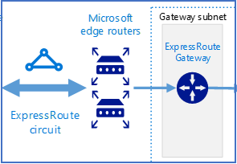
Exercise - Configure an ExpressRoute Gateway
In this exercise, you learn how to:
Task 1: Create the VNet and gateway subnet
Task 2: Create the virtual network gateway
Notes:
It takes 45 minutes to deploy a gateway
To connect your Azure virtual network and your on-premises network via ExpressRoute, you must create a virtual network gateway first. A virtual network gateway serves two purposes: to exchange IP routes between the networks and to route network traffic.
Gateway types
When you create a virtual network gateway, you need to specify several settings. One of the required settings, '-GatewayType', specifies whether the gateway is used for ExpressRoute, or VPN traffic. The two gateway types are:
VPN - To send encrypted traffic across the public Internet, you use the gateway type 'VPN'. This is also referred to as a VPN gateway. Site-to-Site, Point-to-Site, and VNet-to-VNet connections all use a VPN gateway.
ExpressRoute - To send network traffic on a private connection, you use the gateway type 'ExpressRoute'. This is also referred to as an ExpressRoute gateway and is the type of gateway used when configuring ExpressRoute.
Each virtual network can have only one virtual network gateway per gateway type. For example, you can have one virtual network gateway that uses -GatewayType VPN, and one that uses -GatewayType ExpressRoute.
In this exercise, you learn how to:
Create a VNet and a gateway subnet.
Create Virtual Network gateway.

Slide 23
Lesson 04: Exercice - Provision an ExpressRoute circuit

Slide 24
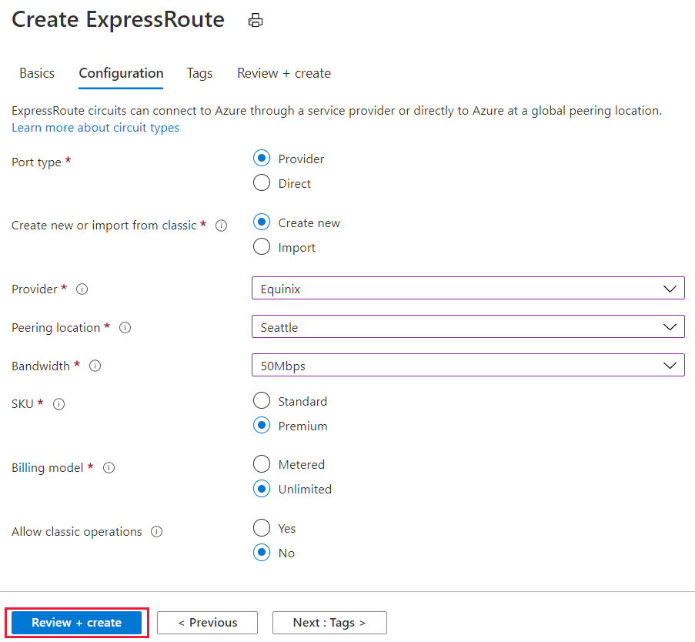
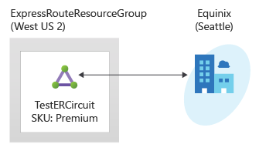
Exercise
In this exercise, you learn how to:
Task 1: Create and provision an ExpressRoute circuit
Task 2: Retrieve your Service key
Task 3: Deprovisioning an ExpressRoute circuit

Slide 25
Lesson 05: Configure peering for an ExpressRoute deployment

Slide 26
Configure peering for an ExpressRoute deployment Overview
Configure Private peering
Configure Microsoft peering
Choose between private peering only, Microsoft peering only, or both
Route filters
Review

Slide 27
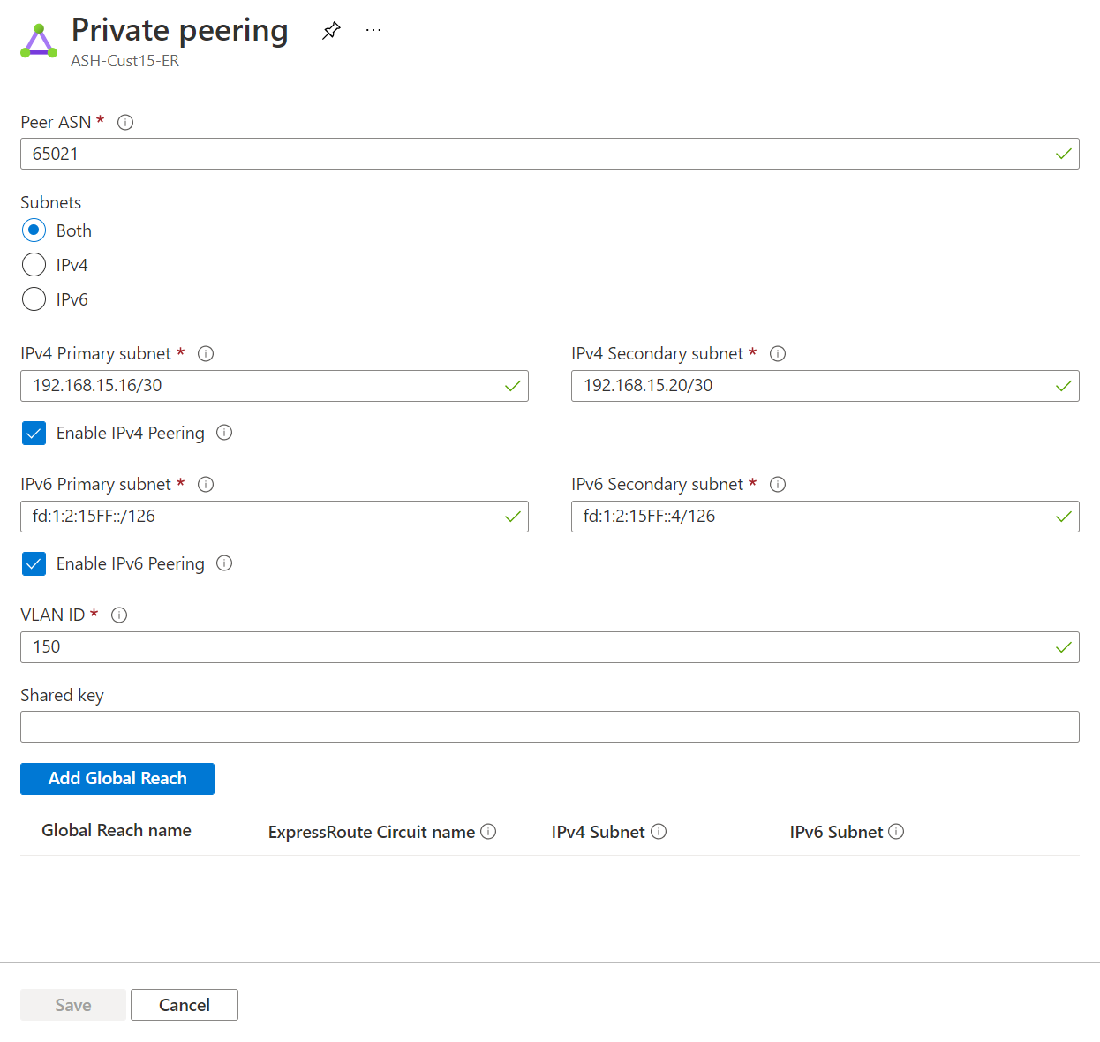
Configure Private peering
A pair of subnets that are not part of any address space reserved for virtual networks. One subnet will be used for the primary link, while the other will be used for the secondary link
A valid on-prem VLAN ID to establish this peering on
AS number for peering
Advertise the routes from your on-premises Edge router to Azure via BGP
Optional - An MD5 hash if you choose to use one
Notes:
A pair of subnets that are not part of any address space reserved for virtual networks. One subnet will be used for the primary link, while the other will be used for the secondary link. From each of these subnets, you will assign the first usable IP address to your router as Microsoft uses the second usable IP for its router. You have three options for this pair of subnets:
IPv4: Two /30 subnets.
IPv6: Two /126 subnets.
Both: Two /30 subnets and two /126 subnets.
A valid VLAN ID to establish this peering on. Ensure that no other peering in the circuit uses the same VLAN ID. For both Primary and Secondary links you must use the same VLAN ID.
AS number for peering. You can use both 2-byte and 4-byte AS numbers. You can use a private AS number for this peering except for the number from 65515 to 65520, inclusively.
You must advertise the routes from your on-premises Edge router to Azure via BGP when you configure the private peering.
Optional - An MD5 hash if you choose to use one.

Slide 28
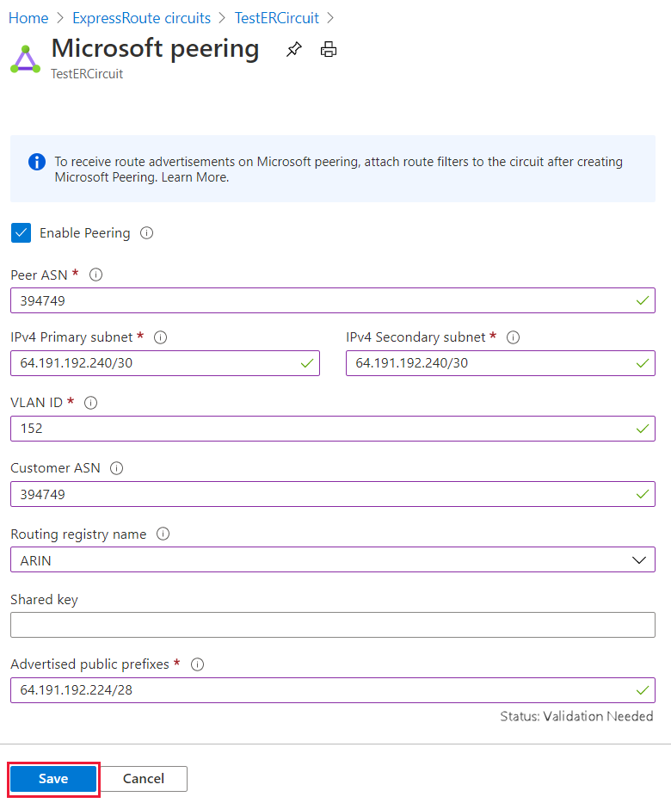
Configure Microsoft peering
A pair of subnets owned by you and registered in an RIR/IRR. One subnet will be used for the primary link, while the other will be used for the secondary link.
A valid on-prem VLAN ID to establish this peering on
AS number for peering
Advertised prefixes: You provide a list of all prefixes you plan to advertise over the BGP session
Routing Registry Name
Notes:
A pair of subnets owned by you and registered in an RIR/IRR. One subnet will be used for the primary link, while the other will be used for the secondary link. From each of these subnets, you will assign the first usable IP address to your router as Microsoft uses the second usable IP for its router. You have three options for this pair of subnets:
IPv4: Two /30 subnets. These must be valid public IPv4 prefixes.
IPv6: Two /126 subnets. These must be valid public IPv6 prefixes.
Both: Two /30 subnets and two /126 subnets.
A valid VLAN ID to establish this peering on. Ensure that no other peering in the circuit uses the same VLAN ID. For both Primary and Secondary links you must use the same VLAN ID.
AS number for peering. You can use both 2-byte and 4-byte AS numbers.
Advertised prefixes: You provide a list of all prefixes you plan to advertise over the BGP session. Only public IP address prefixes are accepted. If you plan to send a set of prefixes, you can send a comma-separated list. These prefixes must be registered to you in an RIR / IRR.
Optional - Customer ASN: If you're advertising prefixes not registered to the peering AS number, you can specify the AS number to which they're registered with.
Routing Registry Name: You can specify the RIR / IRR against which the AS number and prefixes are registered.
Optional - An MD5 hash if you choose to use one.
https://whatismyipaddress.com/rir

Slide 29
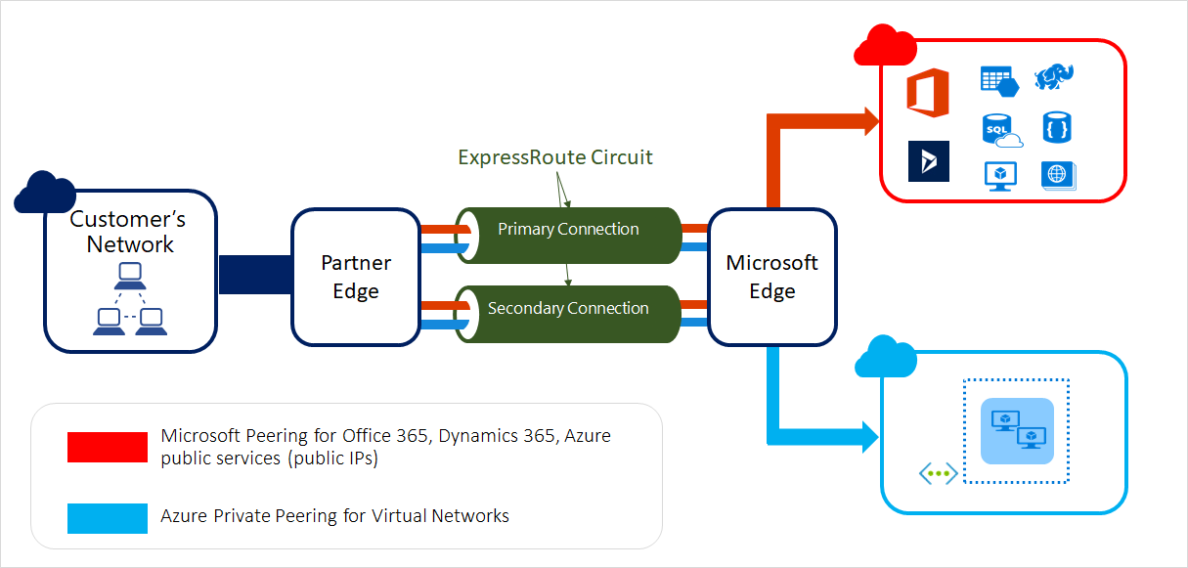
Choose between private peering only, Microsoft peering only, or both

Slide 30
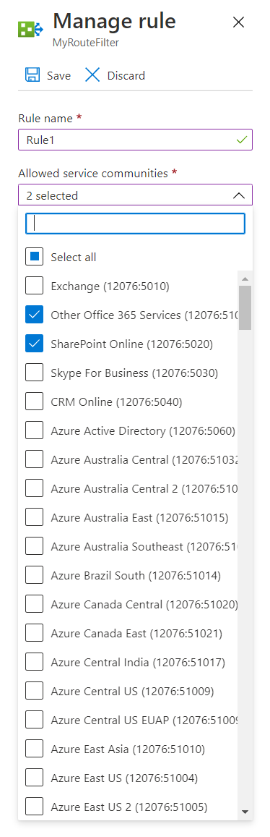
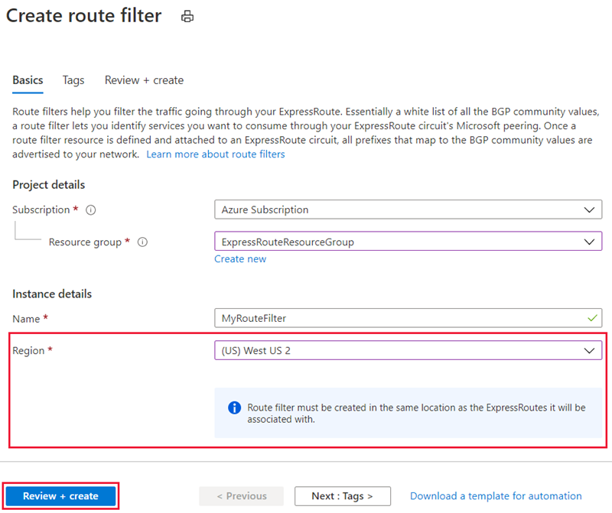
Route filters
Create route filter and create route filter rules
Attach the route filter to an ExpressRoute circuit
Notes:
Azure ExpressRoute: Routing requirements | Microsoft Docs (https://docs.microsoft.com/en-us/azure/expressroute/expressroute-routing#bgp) bgp numbers
Tutorial: Configure route filters for Microsoft peering - Azure portal | Microsoft Docs
Route filters are a way to consume a subset of supported services through Microsoft peering.
Microsoft 365 services such as Exchange Online, SharePoint Online, and Skype for Business, are accessible through the Microsoft peering. When Microsoft peering gets configured in an ExpressRoute circuit, all prefixes related to these services gets advertised through the BGP sessions that are established. A BGP community value is attached to every prefix to identify the service that is offered through the prefix.
Connectivity to all Azure and Microsoft 365 services causes many prefixes gets advertised through BGP. The large number of prefixes significantly increases the size of the route tables maintained by routers within your network. If you plan to consume only a subset of services offered through Microsoft peering, you can reduce the size of your route tables in two ways. You can:
Filter out unwanted prefixes by applying route filters on BGP communities. Route filtering is a standard networking practice and is used commonly within many networks.
Define route filters and apply them to your ExpressRoute circuit. A route filter is a new resource that lets you select the list of services you plan to consume through Microsoft peering. ExpressRoute routers only send the list of prefixes that belong to the services identified in the route filter.

Slide 31
Configure peering for an ExpressRoute deployment- Review
Knowledge Check
Microsoft Learn Modules (docs.microsoft.com/Learn)
Azure ExpressRoute: circuits and peering | Microsoft Docs
Notes:
Learn - https://docs.microsoft.com/en-us/learn/browse/

Slide 32
Lesson 06: Connect an ExpressRoute circuit to a VNet

Slide 33
Connect an ExpressRoute circuit to a VNet Overview
Connect virtual network to an ExpressRoute circuit
Review

Slide 34
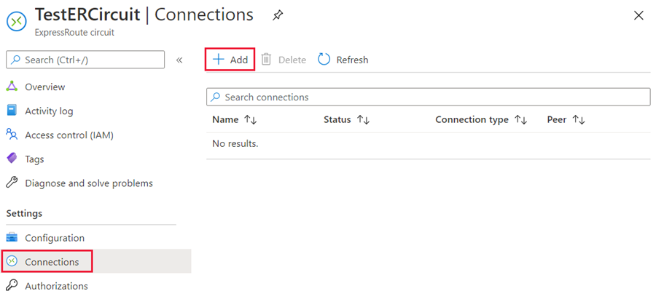
Connect virtual network to an ExpressRoute circuit
Notes:
Azure ExpressRoute: Circuit configuration workflow | Microsoft Docs
Prerequisites
Review the prerequisites, routing requirements, and workflows before you begin configuration.
You must have an active ExpressRoute circuit.
Follow the instructions to create an ExpressRoute circuit and have the circuit enabled by your connectivity provider.
Ensure that you have Azure private peering configured for your circuit. See the Create and modify peering for an ExpressRoute circuit article for peering and routing instructions.
Ensure that Azure private peering gets configured and establishes BGP peering between your network and Microsoft for end-to-end connectivity.
Ensure that you have a virtual network and a virtual network gateway created and fully provisioned. Follow the instructions to create a virtual network gateway for ExpressRoute. A virtual network gateway for ExpressRoute uses the GatewayType 'ExpressRoute', not VPN.
You can link up to 10 virtual networks to a standard ExpressRoute circuit. All virtual networks must be in the same geopolitical region when using a standard ExpressRoute circuit.
A single VNet can be linked to up to 16 ExpressRoute circuits. Use the following process to create a new connection object for each ExpressRoute circuit you're connecting to. The ExpressRoute circuits can be in the same subscription, different subscriptions, or a mix of both.
If you enable the ExpressRoute premium add-on, you can link virtual networks outside of the geopolitical region of the ExpressRoute circuit. The premium add-on will also allow you to connect more than 10 virtual networks to your ExpressRoute circuit depending on the bandwidth chosen. Check the FAQ for more details on the premium add-on.
In order to create the connection from the ExpressRoute circuit to the target ExpressRoute virtual network gateway, the number of address spaces advertised from the local or peered virtual networks needs to be equal to or less than 200. Once the connection has been successfully created, you can add additional address spaces, up to 1,000, to the local or peered virtual networks.
You can view a video before beginning to better understand the steps.

Slide 35
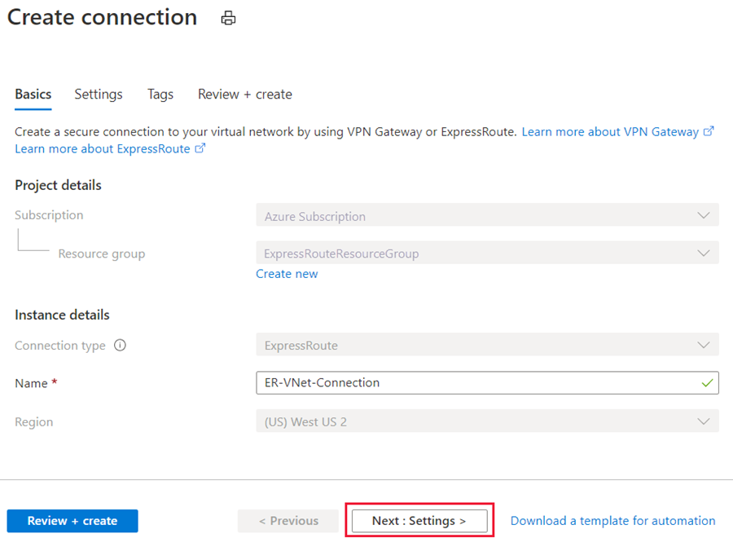
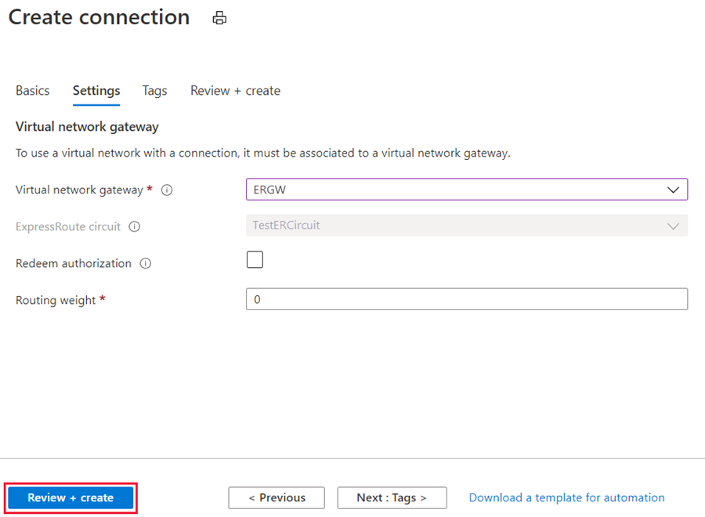
Connect virtual network to an ExpressRoute circuit – continued
Notes:
You can now start provisioning a connection to link your virtual network gateway to your ExpressRoute circuit. Select Connection > Add to open the Add connection page.
Enter a name for the connection and then select Next: Settings >.
Select the gateway that belongs to the virtual network that you want to link to the circuit and select Review + create. Then select Create after validation completes.

Slide 36
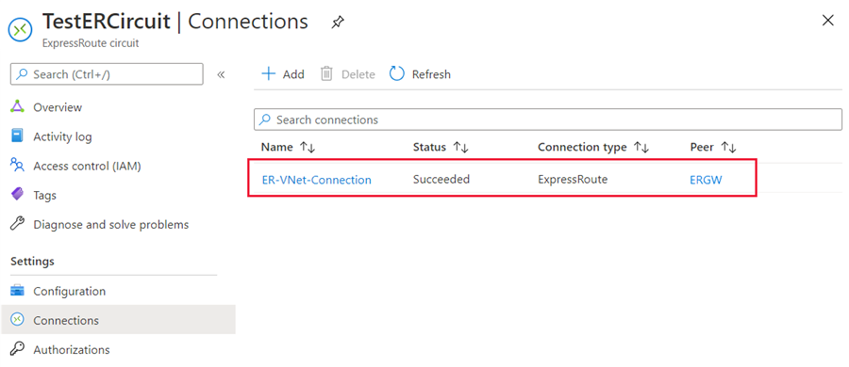
Verify connection
Notes:
After your connection has been successfully configured, your connection object will show the information for the connection.

Slide 37
Connect an ExpressRoute circuit to a VNet - Review
Knowledge Check
Microsoft Learn Modules (docs.microsoft.com/Learn)
Azure ExpressRoute: Circuit configuration workflow | Microsoft Docs
Notes:
Learn - https://docs.microsoft.com/en-us/learn/browse/

Slide 38
Lesson 07: Connect geographically dispersed networks with ExpressRoute Global Reach

Slide 39
Connect geographically dispersed networks with ExpressRoute Global Reach Overview
Use Cross-region connectivity to link multiple ExpressRoutes
Choose when to use ExpressRoute Global Reach
Configure ExpressRoute Global Reach
Review

Slide 40
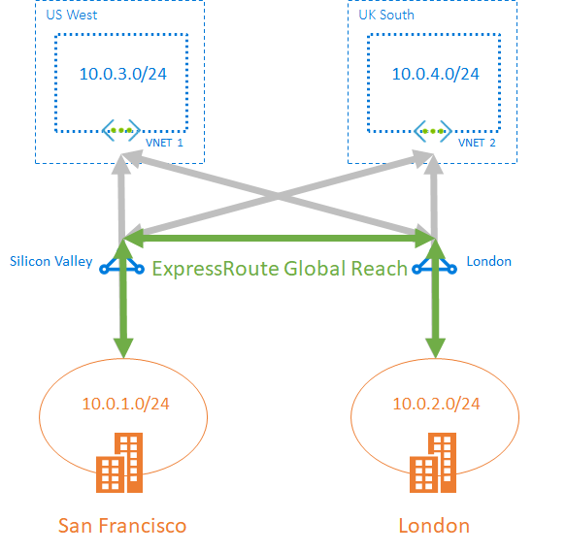
Use Cross-region connectivity to link multiple ExpressRoutes
Connectivity to all regions within a geopolitical region
Global connectivity with ExpressRoute Premium
Local connectivity with ExpressRoute Local
Across on-premises connectivity with ExpressRoute Global Reach
ExpressRoute Direct
Notes:
Fabrikam Inc. acquires Contoso Ltd. Following the merger, Fabrikam wants to interconnect the networks. The following figure illustrates the scenario:
There are various ways of designing and implementing ExpressRoute based on specific organizational requirements.
ExpressRoute connections enable access to the following services:
Microsoft Azure services
Microsoft 365 services
Connectivity to all regions within a geopolitical region
You can connect to Microsoft in one of the peering locations and access regions within the geopolitical region.
For example, if you connect to Microsoft in Amsterdam through ExpressRoute, you will have access to all Microsoft cloud services hosted in Northern and Western Europe.
Global connectivity with ExpressRoute Premium
You can enable ExpressRoute Premium to extend connectivity across geopolitical boundaries. For example, if you connect to Microsoft in Amsterdam through ExpressRoute, you will have access to all Microsoft cloud services hosted in all regions across the world. You can also access services deployed in South America or Australia the same way you access North and West Europe regions. National clouds are excluded.
Local connectivity with ExpressRoute Local
You can transfer data cost-effectively by enabling the Local SKU. With Local SKU, you can bring your data to an ExpressRoute location near the Azure region you want. With Local, Data transfer is included in the ExpressRoute port charge.
Across on-premises connectivity with ExpressRoute Global Reach
You can enable ExpressRoute Global Reach to exchange data across your on-premises sites by connecting your ExpressRoute circuits. For example, if you have a private data center in California connected to an ExpressRoute circuit in Silicon Valley and another private data center in Texas connected to an ExpressRoute circuit in Dallas. With ExpressRoute Global Reach, you can connect your private data centers together through these two ExpressRoute circuits. Your cross-data-center traffic will traverse through Microsoft's network.
Rich connectivity partner ecosystem
ExpressRoute has a constantly growing ecosystem of connectivity providers and systems integrator partners. You can refer to ExpressRoute partners and peering locations.
Connectivity to national clouds
Microsoft operates isolated cloud environments for special geopolitical regions and customer segments.
ExpressRoute Direct
ExpressRoute Direct provides customers the opportunity to connect directly into Microsoft’s global network at peering locations strategically distributed across the world. ExpressRoute Direct provides dual 100-Gbps connectivity, which supports Active/Active connectivity at scale.

Slide 41
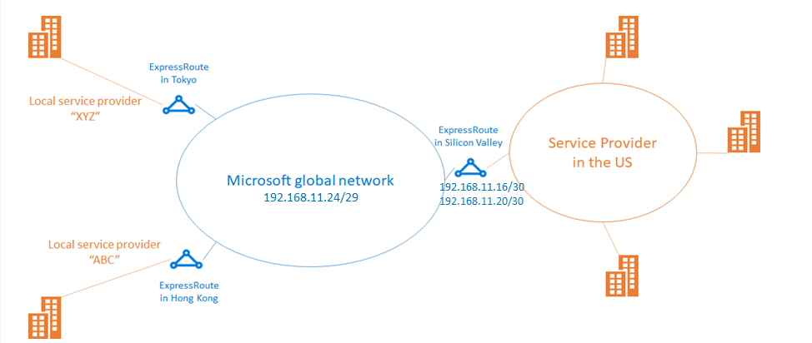
ExpressRoute Global Reach
Designed to complement your service provider’s WAN implementation and connect your branch offices across the world
You can link ExpressRoute circuits together to make a private network between your on-premises networks
Notes:
ExpressRoute Global Reach is designed to complement your service provider’s WAN implementation and connect your branch offices across the world. For example, if your service provider primarily operates in the United States and has linked all of your branches in the U.S., but the service provider doesn’t operate in Japan and Hong Kong SAR, with ExpressRoute Global Reach you can work with a local service provider and Microsoft will connect your branches there to the ones in the U.S. using ExpressRoute and our global network.

Slide 42
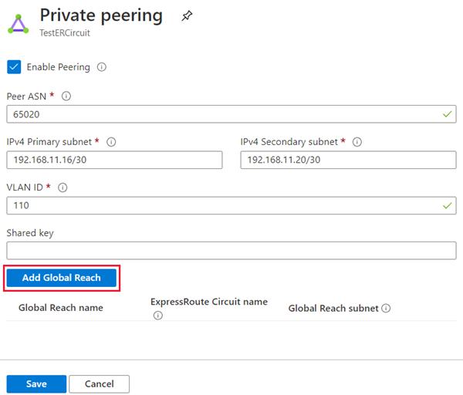
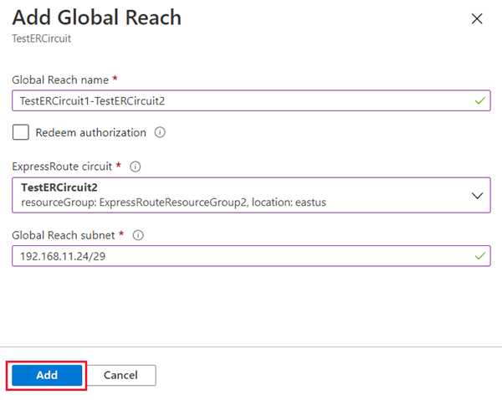
Configure ExpressRoute Global Reach

Slide 43
Connect geographically dispersed networks with ExpressRoute Global Reach - Review
Knowledge Check
Microsoft Learn Modules (docs.microsoft.com/Learn)
Azure ExpressRoute: Connect to Microsoft Cloud using Global Reach | Microsoft Docs
Notes:
Learn - https://docs.microsoft.com/en-us/learn/browse/

Slide 44
Lesson 08: Improve data path performance between networks with ExpressRoute FastPath

Slide 45
Improve data path performance between networks with ExpressRoute FastPath Overview
ExpressRoute FastPath
Configure ExpressRoute FastPath
Review

Slide 46
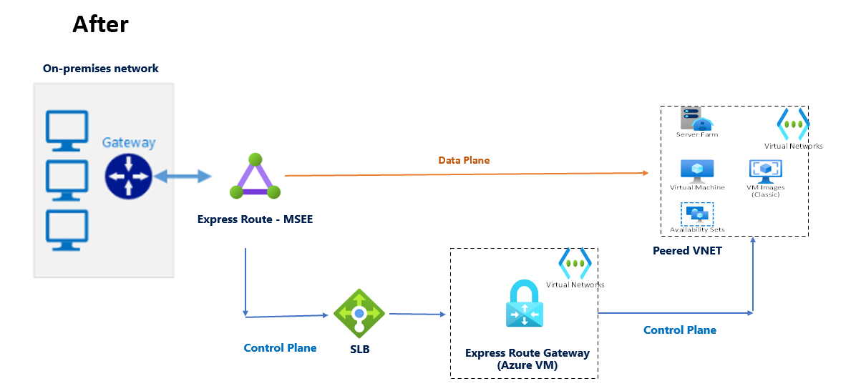
ExpressRoute FastPath
FastPath is designed to improve the data path performance between your on-premises network and your virtual network
When enabled, FastPath sends network traffic directly to virtual machines in the virtual network, bypassing the gateway.
FastPath improves data path performance such as packets per second and connections per second between your on-premises network and your virtual network.
You can enable ExpressRoute FastPath if your virtual network gateway is Ultra Performance or ErGw3AZ
Notes:
ExpressRoute virtual network gateway is designed to exchange network routes and route network traffic. FastPath is designed to improve the data path performance between your on-premises network and your virtual network. When enabled, FastPath sends network traffic directly to virtual machines in the virtual network, bypassing the gateway.
While FastPath supports most configurations, it does not support the following features:
UDR on the gateway subnet: This UDR has no impact on the network traffic that FastPath sends directly from your on-premises network to the virtual machines in Azure virtual network.
VNet Peering: If you have other virtual networks peered with the one that is connected to ExpressRoute, the network traffic from your on-premises network to the other virtual networks (i.e., the so-called "Spoke" VNets) will continue to be sent to the virtual network gateway. The workaround is to connect all the virtual networks to the ExpressRoute circuit directly.
Basic Load Balancer: If you deploy a Basic internal load balancer in your virtual network or the Azure PaaS service you deploy in your virtual network uses a Basic internal load balancer, the network traffic from your on-premises network to the virtual IPs hosted on the Basic load balancer will be sent to the virtual network gateway. The solution is to upgrade the Basic load balancer to a Standard load balancer.
Private Link: If you connect to a private endpoint in your virtual network from your on-premises network, the connection will go through the virtual network gateway.

Slide 47
Configure ExpressRoute FastPath
Configure FastPath on a new connection using PowerShell
Get-AzExpressRouteCircuit -Name $ExpressRouteCircuitName -ResourceGroupName $RGName
Get-AzVirtualNetworkGateway -Name $VirtualNetworkGatewayName -ResourceGroupName $RGName $connection = New-AzVirtualNetworkGatewayConnection -Name $ConnectionName -ResourceGroupName $RGName -ExpressRouteGatewayBypass -VirtualNetworkGateway1 $gw -PeerId $circuit.Id -ConnectionType ExpressRoute -Location $location
Notes:
If you plan to use FastPath with IPv6-based private peering over ExpressRoute, make sure to select ErGw3AZ for SKU. Note that this is only available for circuits using ExpressRoute Direct.
FastPath still requires a virtual network gateway to be created to exchange routes between virtual network and on-premises network. For more information about virtual network gateways and ExpressRoute, including performance information and gateway SKUs, see ExpressRoute virtual network gateways.
To configure FastPath, the virtual network gateway must be either:
Ultra Performance
ErGw3AZ
https://docs.microsoft.com/en-us/azure/expressroute/about-fastpath
https://docs.microsoft.com/en-us/azure/expressroute/expressroute-howto-linkvnet-arm#configure-expressroute-fastpath

Slide 48
Improve data path performance between networks with ExpressRoute FastPath - Review
Knowledge Check
Microsoft Learn Modules (docs.microsoft.com/Learn)
About Azure ExpressRoute FastPath | Microsoft Docs
Notes:
Learn - https://docs.microsoft.com/en-us/learn/browse/

Slide 49
Lesson 09: Troubleshoot ExpressRoute connection issues

Slide 50
Troubleshoot ExpressRoute connection issues Overview
Verify circuit provisioning and state through the Azure portal
Validate Peering Configuration
Validate Address Resolution Protocol (ARP)
Troubleshooting network performance
Review

Slide 51
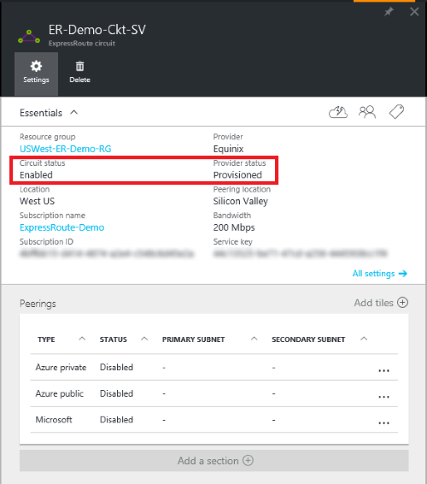
Verify circuit provisioning and state
Get-AzExpressRouteCircuit -ResourceGroupName “USWest-ER-Demo-RG” –Name “ER-Demo-Ckt-SV”
Name : ER-Demo-Ckt-SV
ResourceGroupName : USWest-ER-Demo-RG
Location : westus
Id : /subscriptions/***************************/resourceGroups/ USWest-ER-Demo-RG /providers/***********/expressRouteCircuits/ ER-Demo-Ckt-SV
Etag : W/"################################"
ProvisioningState : Succeeded
Sku : {
"Name": "Standard_UnlimitedData",
"Tier": "Standard",
"Family": "UnlimitedData"
}
CircuitProvisioningState : Enabled
ServiceProviderProvisioningState : Provisioned
ServiceProviderNotes :
ServiceProviderProperties : {
"ServiceProviderName": "****",
"PeeringLocation": "******",
"BandwidthInMbps": 200
}
ServiceKey : **************************************
Peerings : []
Authorizations : []
Notes:
In the Azure portal, open the ExpressRoute circuit blade. In the section of the blade, the ExpressRoute essentials are listed as shown in the following screenshot:
In the ExpressRoute Essentials, Circuit status indicates the status of the circuit on the Microsoft side. Provider status indicates if the circuit has been Provisioned/Not provisioned on the service-provider side.
For an ExpressRoute circuit to be operational, the Circuit status must be Enabled and the Provider status must be Provisioned.
Provisioning an ExpressRoute circuit establishes a redundant Layer 2 connections between CEs/PE-MSEEs (2)/(4) and MSEEs (5).
The following are the logical steps, in troubleshooting ExpressRoute circuit:
Verify circuit provisioning and state
Validate Peering Configuration
Validate ARP
Validate BGP and routes on the MSEE
Confirm the traffic flow

Slide 52
Reset a failed circuit
Connect-AzAccount
Get-AzSubscription
Select-AzSubscription -SubscriptionName "Replace_with_your_subscription_name“
$ckt = Get-AzExpressRouteCircuit -Name "ExpressRouteARMCircuit" -ResourceGroupName "ExpressRouteResourceGroup"
Set-AzExpressRouteCircuit -ExpressRouteCircuit $ckt
The circuit should now be healthy. Open a support ticket with Microsoft support if the circuit is still in a failed state.
Notes:
When an operation on an ExpressRoute circuit doesn't complete successfully, the circuit may go into a 'failed' state. This article will help you reset a failed Azure ExpressRoute circuit.
The steps and examples in this article use Azure PowerShell Az modules. To install the Az modules locally on your computer, see Install Azure PowerShell. To learn more about the new Az module, see Introducing the new Azure PowerShell Az module. PowerShell cmdlets are updated frequently. If you are not running the latest version, the values specified in the instructions may fail. To find the installed versions of PowerShell on your system, use the Get-Module -ListAvailable Az cmdlet.

Slide 53
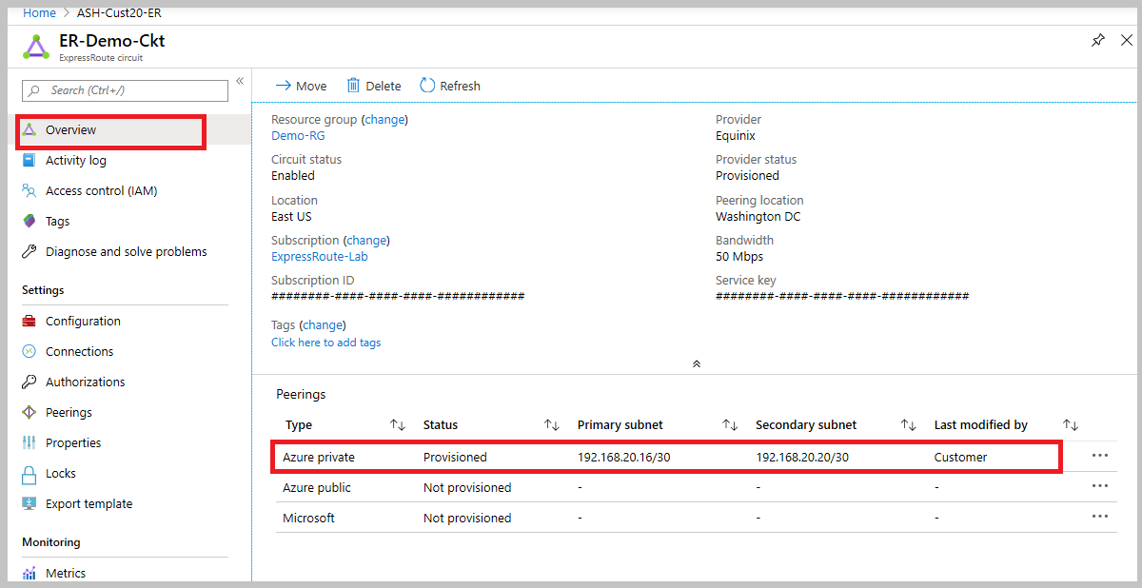
Validate Peering Configuration
Notes:
After the service provider has completed the provisioning the ExpressRoute circuit, multiple eBGP based routing configurations can be created over the ExpressRoute circuit between CEs/MSEE-PEs (2)/(4) and MSEEs (5). Each ExpressRoute circuit can have: Azure private peering (traffic to private virtual networks in Azure), and/or Microsoft peering (traffic to public endpoints of PaaS and SaaS).
In the preceding example, as noted Azure private peering is provisioned, whereas Azure public and Microsoft peerings are not provisioned. A successfully provisioned peering context would also have the primary and secondary point-to-point subnets listed. The /30 subnets are used for the interface IP address of the MSEEs and CEs/PE-MSEEs. For the peerings that are provisioned, the listing also indicates who last modified the configuration.
Another way is PowerShell:
$ckt = Get-AzExpressRouteCircuit -ResourceGroupName "Test-ER-RG" -Name "Test-ER-Ckt"
Get-AzExpressRouteCircuitPeeringConfig -Name "AzurePrivatePeering" -ExpressRouteCircuit $ckt

Slide 54
Validate ARP
Address Resolution Protocol (ARP):
layer 2 protocol defined in RFC 826.
Used to map the Ethernet address (MAC address) with an ip address.
The ARP table provides a mapping of the IP address and MAC address for a particular peering. The ARP table for an ExpressRoute circuit peering provides the following information for each interface (primary and secondary):
Mapping of on-premises router interface ip address to the MAC address
Mapping of ExpressRoute router interface ip address to the MAC address
Age of the mapping ARP tables can help validate layer 2 configuration and troubleshooting basic layer 2 connectivity issues.
Title of ARP table error messages:
- On-premises MAC address show incomplete
- Microsoft entry in the ARP table
Notes:
Address Resolution Protocol (ARP) is a layer 2 protocol defined in RFC 826. ARP is used to map the Ethernet address (MAC address) with an ip address.
The ARP table provides the following information for both the primary and secondary interfaces for each peering types:
Mapping of on-premises router interface ip address to the MAC address
Mapping of ExpressRoute router interface ip address to the MAC address
Age of the mapping
ARP tables can help validate layer 2 configuration and troubleshooting basic layer 2 connectivity issues.
ARP table when Microsoft side has problems
You won't see an ARP table shown for a peering if there are issues on the Microsoft side.
Open a support ticket with Microsoft support. Specify that you have an issue with layer 2 connectivity.
Next Steps
Validate Layer 3 configurations for your ExpressRoute circuit.
Get route summary to determine the state of BGP sessions.
Get route table to determine which prefixes are advertised across ExpressRoute.
Validate data transfer by reviewing bytes in / out.
Open a support ticket with Microsoft support if you're still experiencing issues.

Slide 55
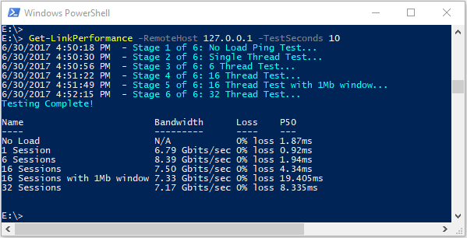
Troubleshooting network performance
Most network issues can be analyzed and isolated with Azure Network Watcher or PowerShell and CLI
To help with troubleshooting, the Azure Connectivity Toolkit (AzureCT) was developed to put some of these tools in an easy package.
These tools and methods are wrapped into a PowerShell module (AzureCT) that you can install and use
Notes:
Network watcher
Powershell and CLI
Most network issues can be analyzed and isolated using basic tools like ping and traceroute. It's rare you need to go as deep as a packet analysis using tools like Wireshark.
To help with troubleshooting, the Azure Connectivity Toolkit (AzureCT) was developed to put some of these tools in an easy package. For performance testing, tools like iPerf and PSPing can provide you information about your network. iPerf is a commonly used tool for basic performances tests and is fairly easy to use. PSPing is a ping tool developed by SysInternals. PSPing can do both ICMP and TCP pings to reach a remote host. Both of these tools are lightweight and are "installed" simply by coping the files to a directory on the host.
These tools and methods are wrapped into a PowerShell module (AzureCT) that you can install and use.

Slide 56
Troubleshoot ExpressRoute connection issues - Review
Knowledge Check
Microsoft Learn Modules (docs.microsoft.com/Learn)
Azure ExpressRoute: Verify Connectivity - Troubleshooting Guide | Microsoft Docs
Troubleshoot network link performance: Azure | Microsoft Docs
Reset a failed circuit - ExpressRoute: PowerShell: Azure | Microsoft Docs
Notes:
Learn - https://docs.microsoft.com/en-us/learn/browse/

Slide 57
End of presentation

